Slide 1
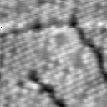
Advances in Scanning Probe Microscopy
Eric I. Altman¹ and Udo D. Schwarz^{1,2}
¹Department of Chemical & Environmental Engineering
²Department of Mechanical Engineering & Materials Science
https://seas.yale.edu/faculty-research/faculty-directory/eric-altman
https://www.eng.yale.edu/nanomechanics/

Slide 2
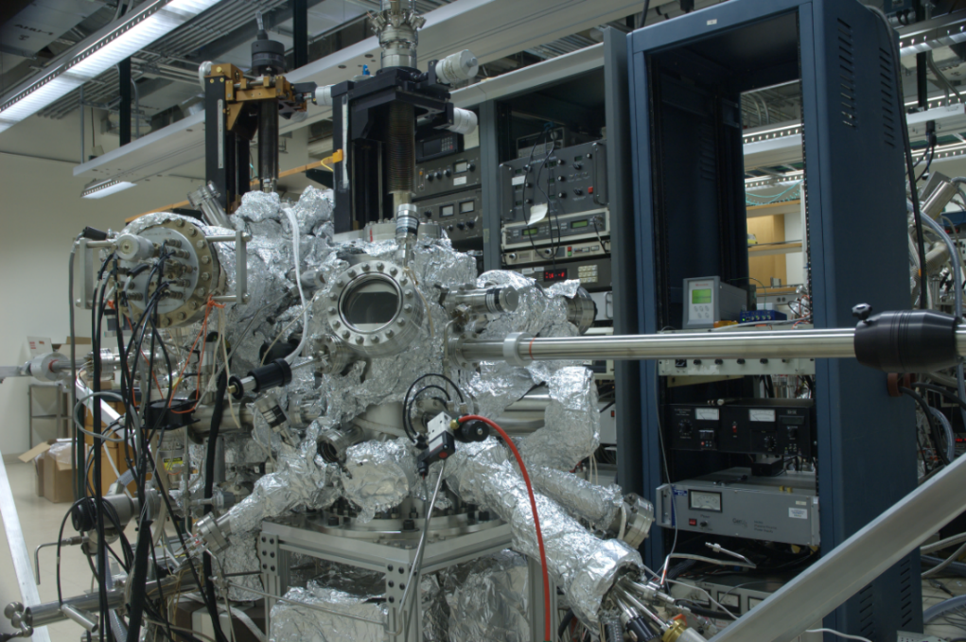
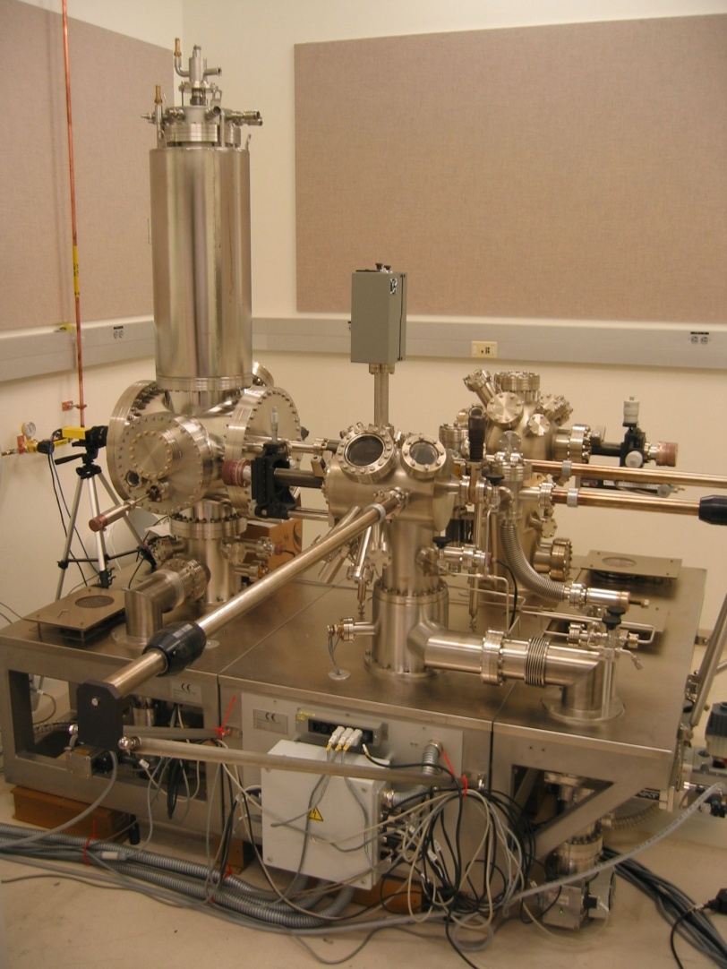
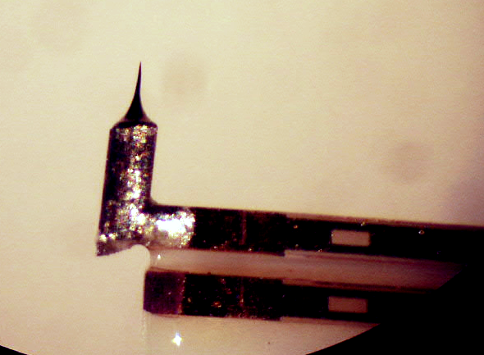
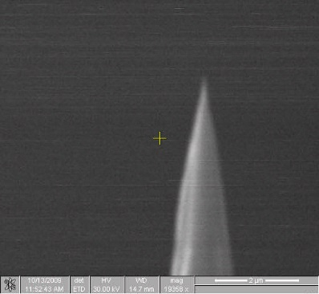
Atomic Resolution Surface Imaging and Characterization
Canal Level – Malone Engineering Center
Altman Lab:
UHV STM in Surface Analysis System with Small Growth Chamber.
300 – 900 K, up to 3 images/sec
Focus on imaging chemical and physical processes on surfaces as they occur.
Schwarz Lab:
UHV Low T Combined STM/AFM.
≈ 4 K, interrogate the same atom for hours.
Focus on chemical and physical property characterization with high spatial and energy resolution.

Slide 3
Developing the Ideal Surface Microscopy/Spectroscopy Tool
In a single experiment:
Image atoms
Identify types of atoms
Determine the chemical states of atoms
Characterize individual chemical bonds
Measure molecule-surface interaction energies
Measure molecule-molecule interaction energies
Characterize overlap of electronic states responsible for the interactions
Probe specific atoms on demand
Assemble structures with atomic precision and measure the energetics of each step

Slide 4
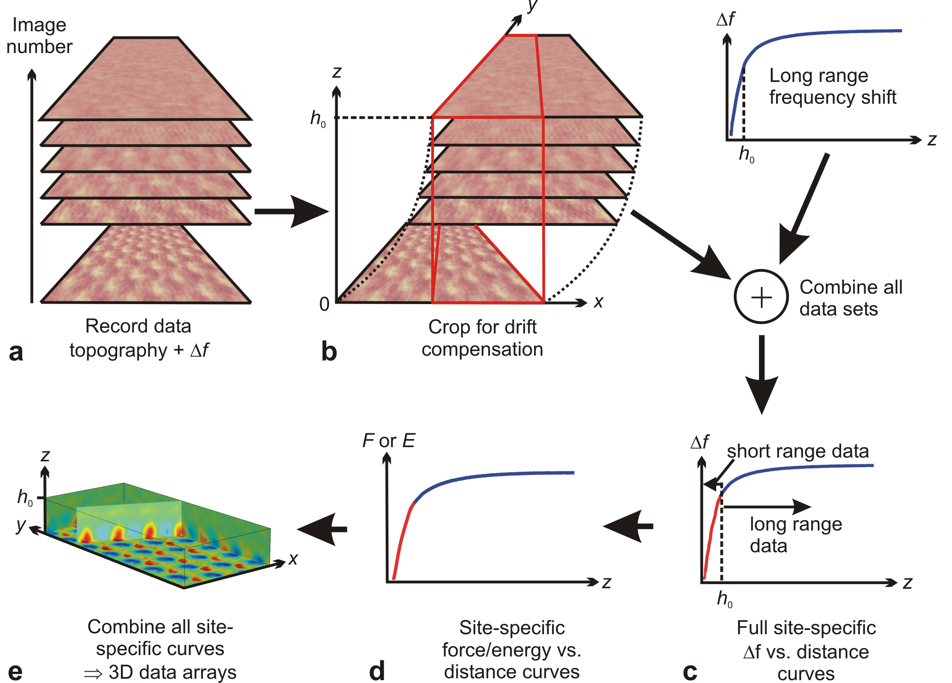
Mapping Molecule-Surface Interactions – 3D-AFM

Slide 5
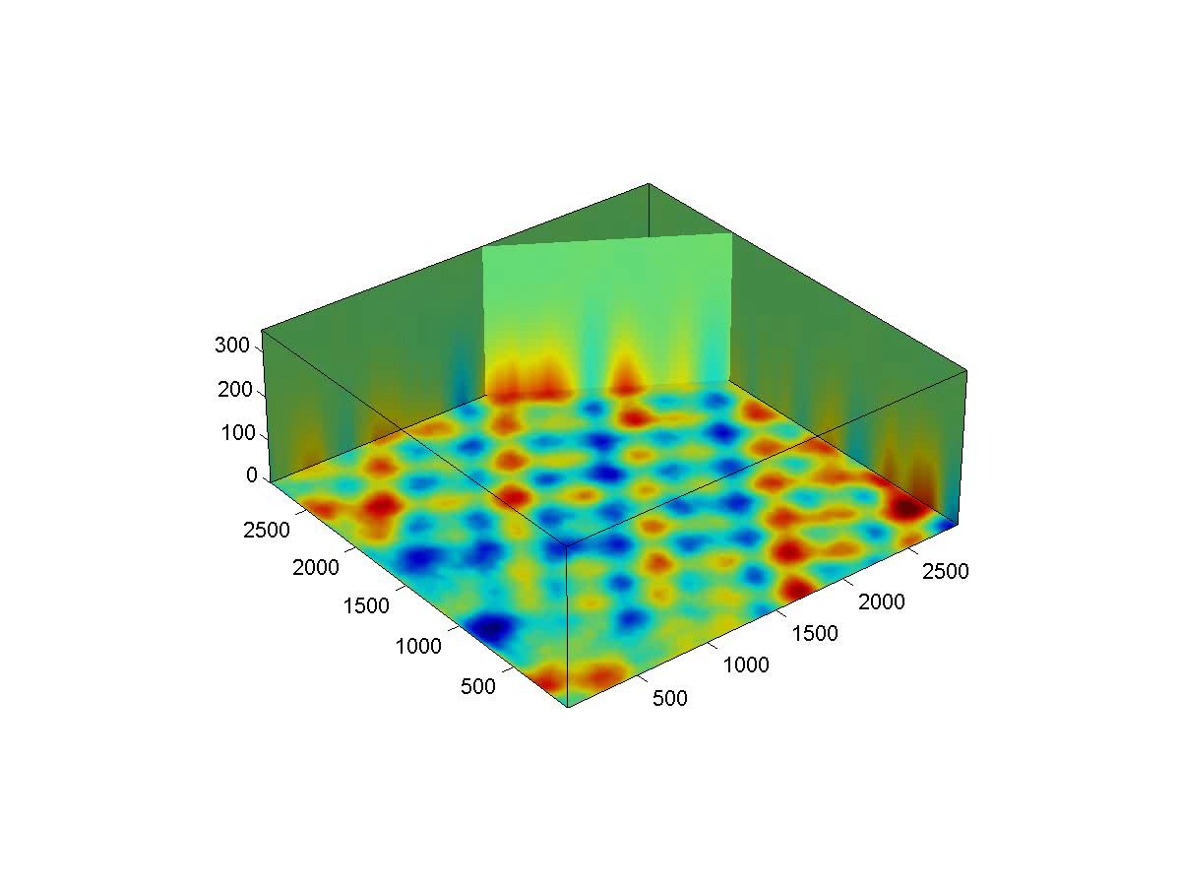
3D AFM – Surface Oxide Layer on Cu(100)
Potential Energy Landscape
Average energy subtracted; color scale: -9.4 meV (dark blue) to 9.4 meV (dark red)

Slide 6
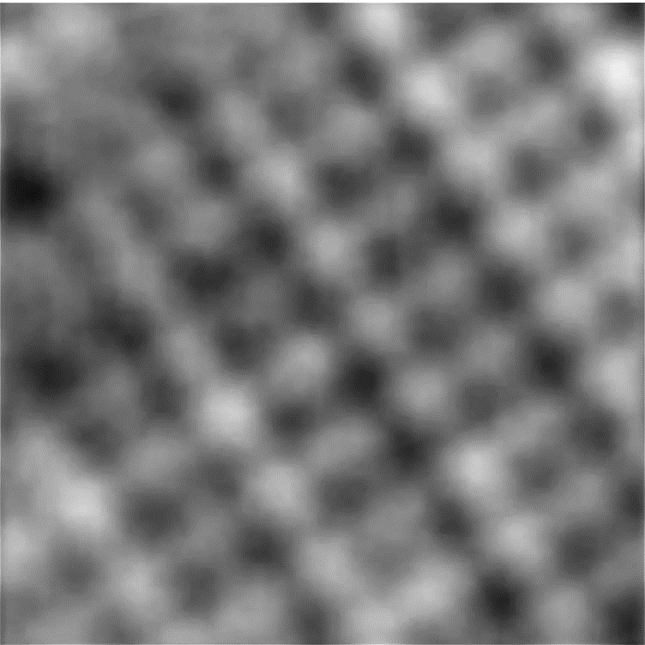
Multi-Dimensional Imaging – Distinguishing Types of Atoms
Potential Energy → Tunneling Current
The tunneling current maxima are between the rows of maxima in the potential energy image.
The current image reflects the rows of Cu atoms between the O rows.

Slide 7
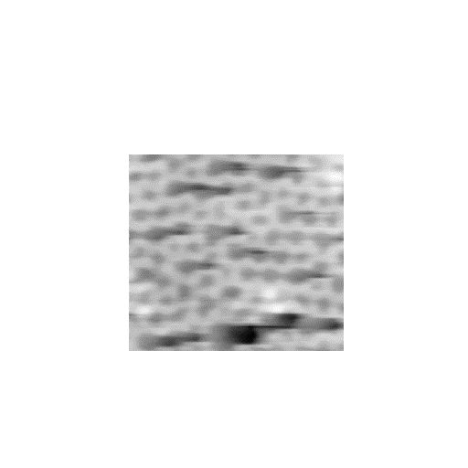
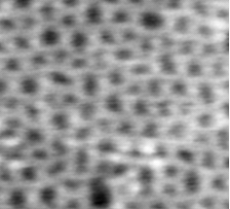
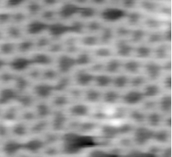
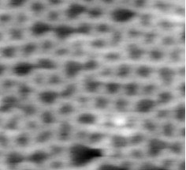
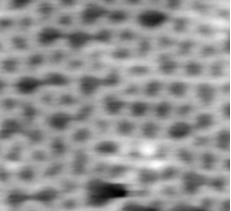
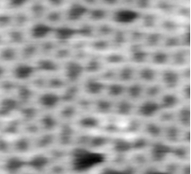
Characterizing Overlap of Electronic States Responsible for Chemical Interactions
3D-STM
Amorphous 2D SiO₂ -2.75 - -0.75 V
V
z–V spectra equivalent to ln(I)–V curves.

Slide 8
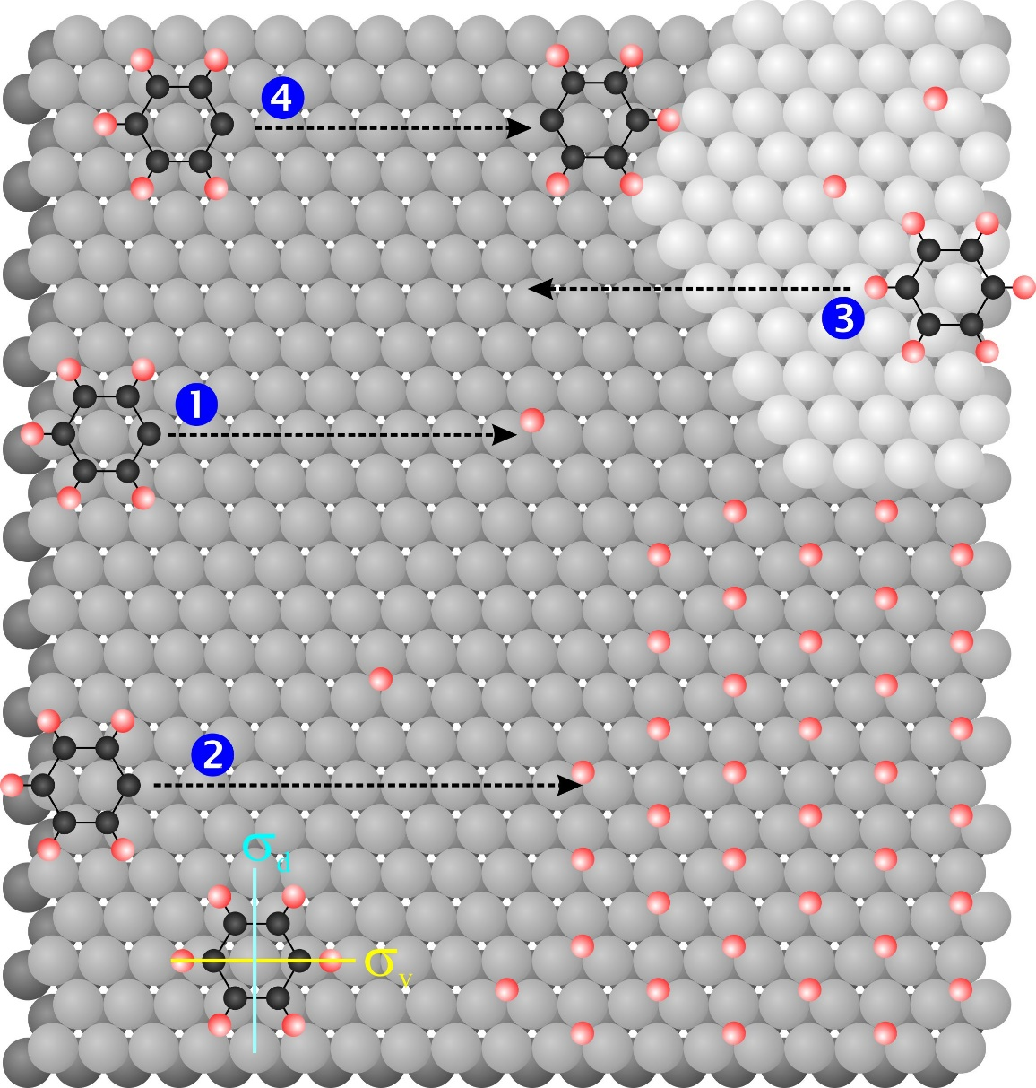
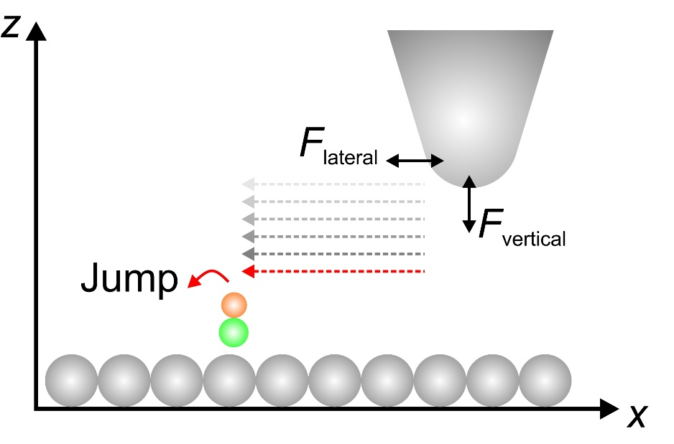
Measuring Molecule-Molecule Interactions

Slide 9
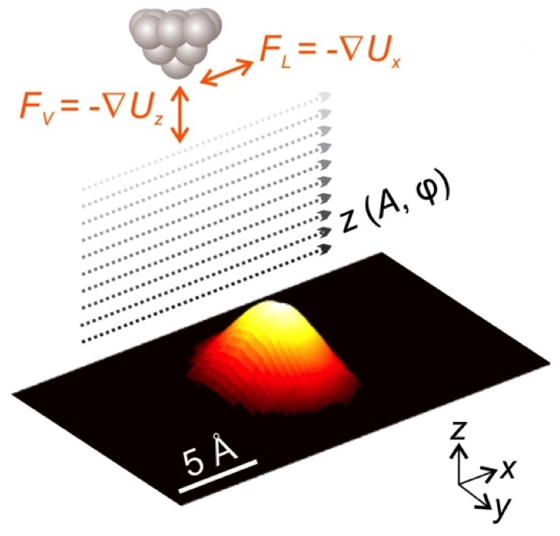
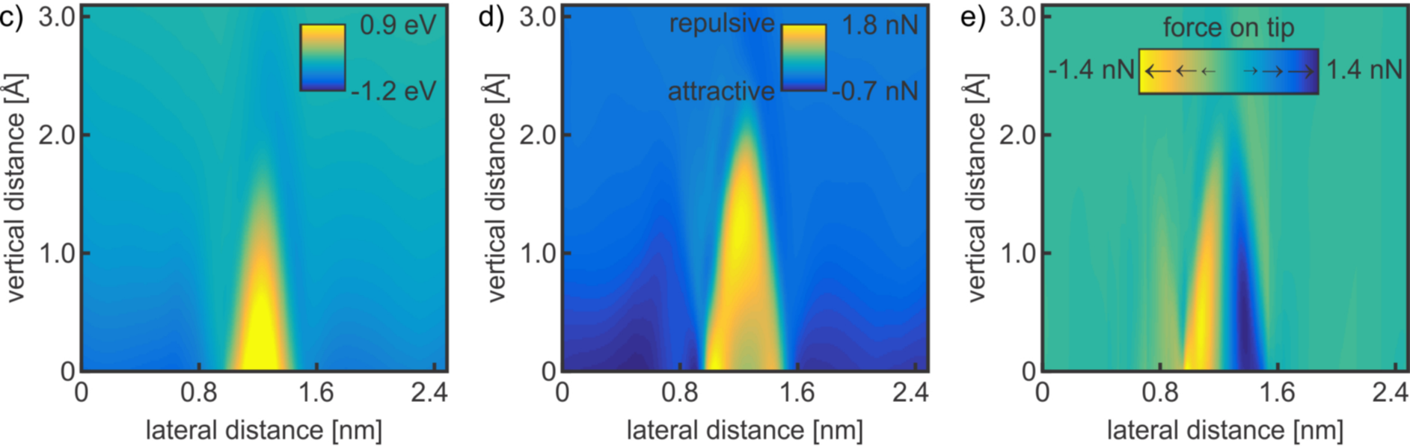
Measuring Molecule-Molecule Interactions
Data for C₆H₅I
Potential Energy
Vertical Force
Lateral Force

Slide 10
Contribution to Yale Community
Unique surface imaging and combined surface analysis capabilities.
Expertise in long-term, high-precision measurements.
Expertise in frequency-based methods.
Critical Needs
Access to rapid electronics development, prototyping, etc.
Assistance with more rapidly developing data acquisition and analysis software.
Development of methods for rapid image and data analysis- potentially a large amount of data in the detailed tip trajectory.
How Can Yale Instrumentation Initiative Help?
Meet above critical needs.
Development of a user high-resolution SPM facility to work with the Yale community on a broad range of problems.

Slide 11
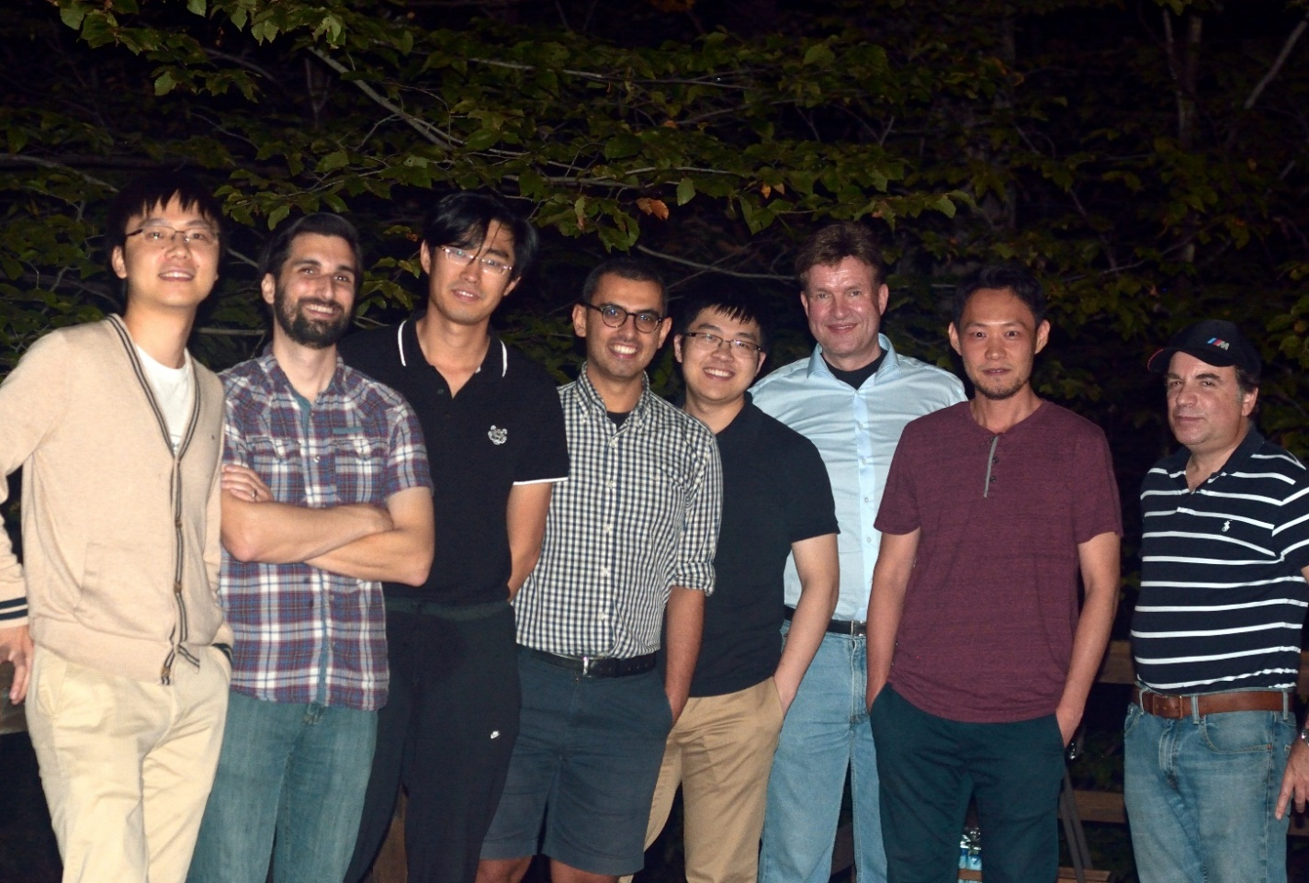
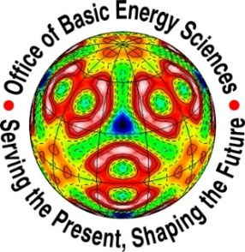


Department of Energy Basic Energy Sciences
National Science Foundation Chemistry and Materials Research Divisions
Petroleum Research Fund
Yale Center for Research on Interface Structure and Phenomena

